Slide 1
Intro to GitHub

Slide 2
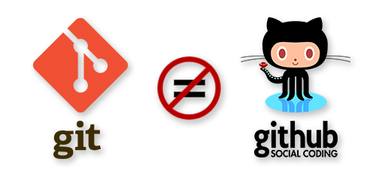
https://jahya.net/blog/git-vs-github/
Notes:
Git is not GitHub
One is a piece of software. The other is a hosting service.

Slide 3
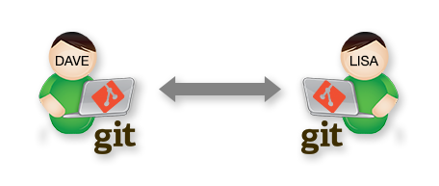
https://jahya.net/blog/git-vs-github/
Notes:
Git is distributed version control. That means that you can each be working with copies of the same stuff and send changes to each other's machines.

Slide 4
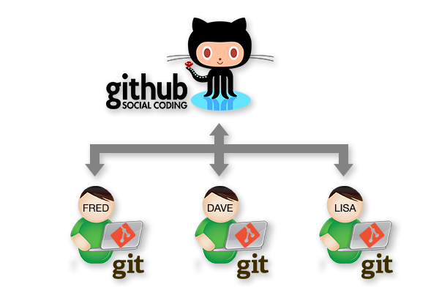
https://jahya.net/blog/git-vs-github/
Notes:
GitHub is a hosting service, a third party, that helps you keep track of the collaborations taking place among various developers. Rather than having one person's computer act as master, the master version is held in the cloud. And we all interact with it through a variety of commands.

Slide 5
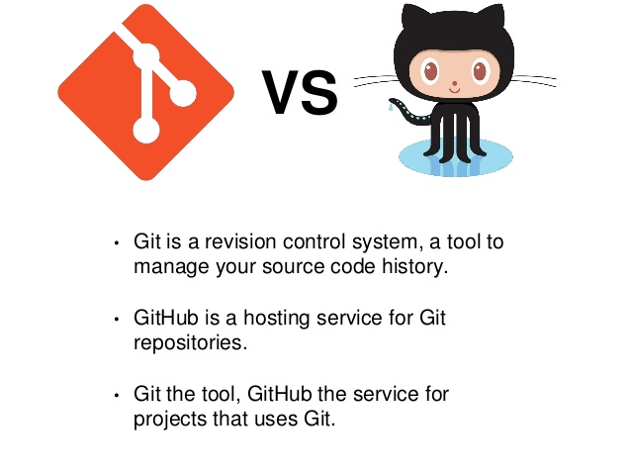
https://www.slideshare.net/manishsuwal/using-git-to-organize-your-project

Slide 6

https://www.amarinfotech.com/gitlab-vs-github-vs-bitbucket.html

Slide 7
Major commands
Pushing
Send your local commits to GitHub
$ git push
First time it will likely be $ git push origin master
Pulling
Take commits on GitHub from someone else and merge them with yours
$ git pull

Slide 8
Other Concepts
repository
A collection of files
fork
GitHub command for creating a copy on your GitHub repository
cloning
copy a repository from GitHub to your machine
$ git clone https://github.com/walshbr/ohio-five-workshop.git
(last bit is unique to the repo)

Slide 9
Last Concepts…
Remote
"place where code is held"
See which ones you have stored locally with
$ git remote –v
Most repositories start with one named "origin", which is just the master version of the repo on GitHub

Slide 10
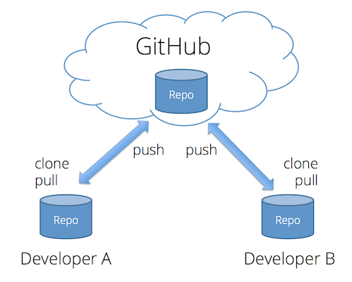
https://faculty.washington.edu/dlsinfo/tutorials/essential-git/
Notes:
To review – what is the remote?

Slide 11

Notes:
Don't panic! It takes a while to get all of this. It's basically a rote memorization thing. There are a ton of concepts, but you only really interact with a few of them.

Slide 12
Helpful Resources
On our course website under Resources:
GitHub CheatSheet
GitHub Troubleshooting
Git Cheatsheet
Notes:
Some resources. Now let's work together.

Slide 13
Portfolios
During the week we will code a lot.
We're going to set you up with a portfolio website of you very own to showcase your work.
Throughout the week you will send content to the site to practice and show off your progress.

Slide 14
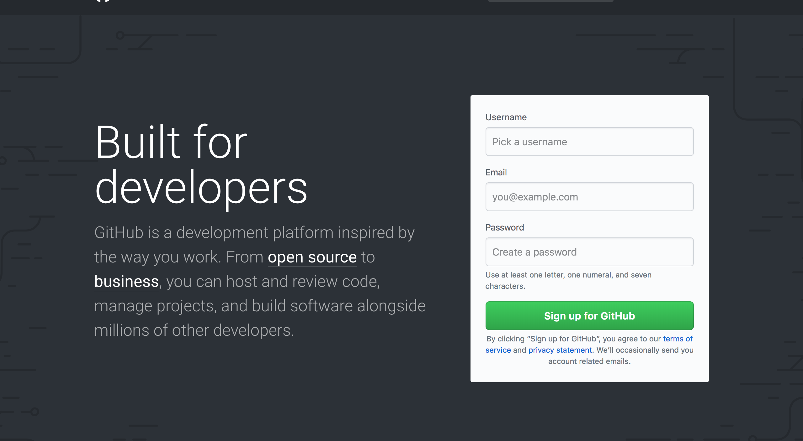
github.com
Notes:
step one – sign up

Slide 15
Verify
Second step is to verify your account – you should have gotten an email to the account you linked to.
Notes:
Sign up for a GitHub account at https://github.com/join. You want your username to be descriptive of your digital identity. This will become your domain, so be mindful of that. For example, my GitHub username is walshbr.

Slide 16
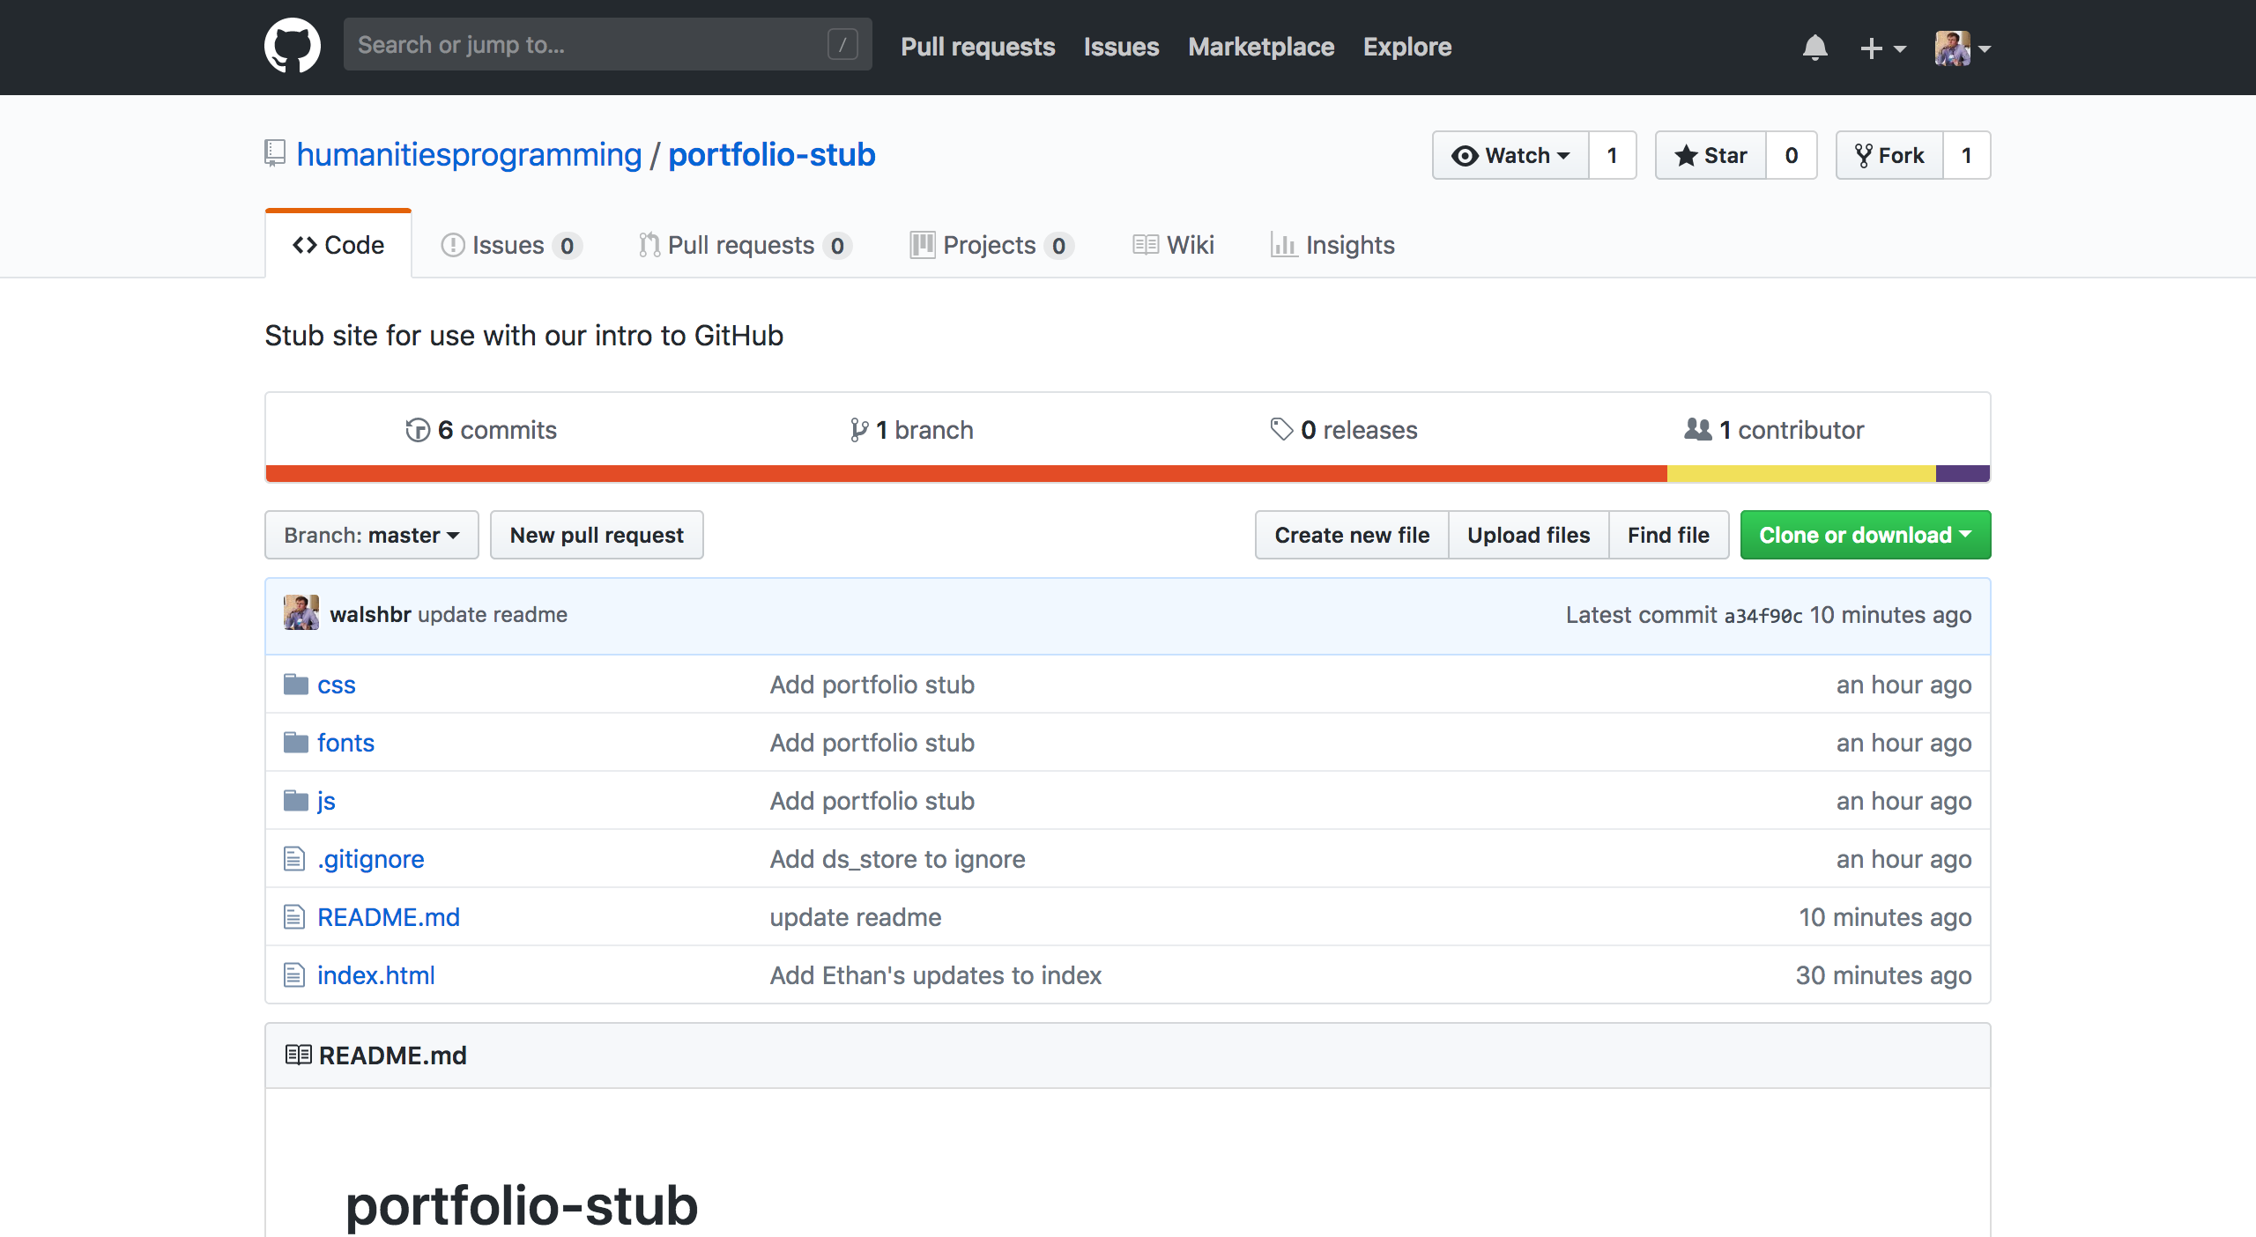
http://bit.ly/2spygd4
Notes:
visit this url - https://github.com/humanitiesprogramming/portfolio-stub

Slide 17

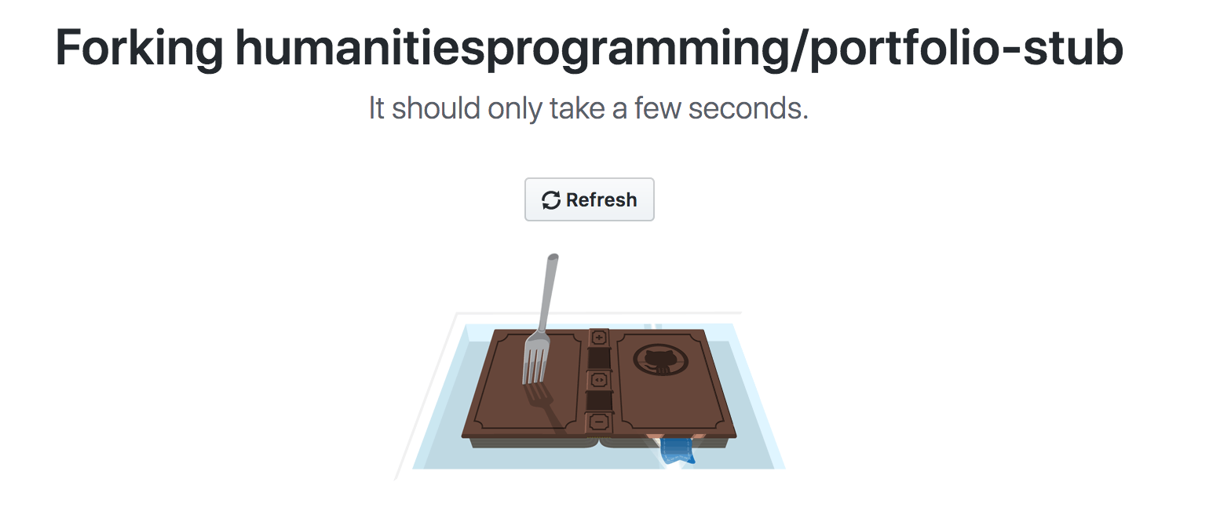
Fork
Notes:
Click the fork button in the top right to copy the stub portfolio to your GitHub account. You'll be redirected to a new page after you're done.

Slide 18
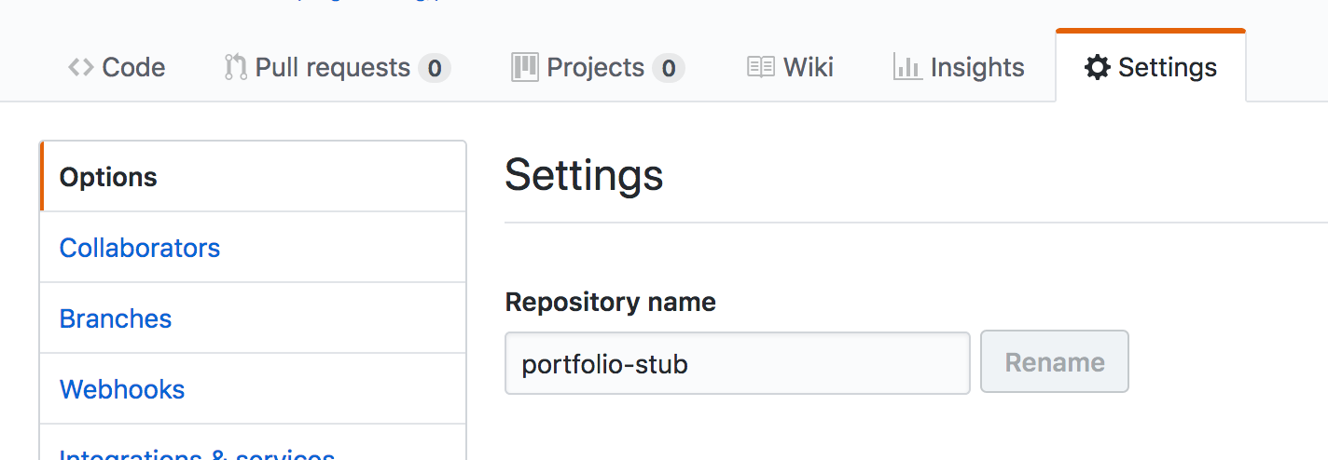
Rename Repository
Notes:
Click the gear icon to access the "settings" for your new repository. In there, search for "repository name" and change it from "portfolio-stub" to be .github.io, where is your unique username. I.e., if your username is reedeth on GitHub your repository name would be reedeth.github.io. Click rename.

Slide 19
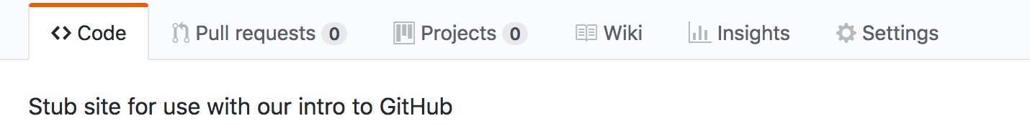
Notes:
Click back to the "code" tab.
Look for the button that says "clone or download." Click it. Copy the link in it to your clipboard by either highlighting and copying or clicking the keyboard.

Slide 20
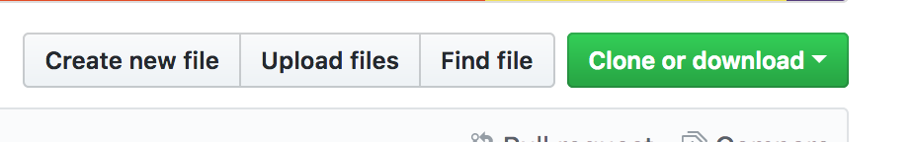
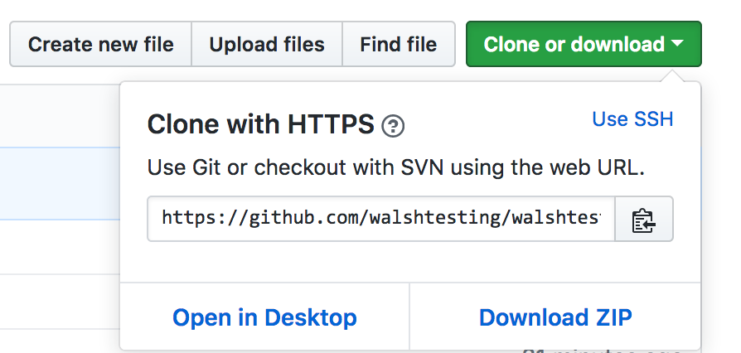
Notes:
Look for the button that says "clone or download." Click it. Copy the link in it to your clipboard by either highlighting and copying or clicking the keyboard.
MAKE SURE YOU'RE CLONING WITH HTTPS

Slide 21
Getting a Local Copy
$ cd ~/Desktop
$ git clone THE_SLUG_YOU_COPIED
$ cd YOUR_REPO_NAME
$ atom index.html

Slide 22
Make a Change!
<h1>A most excellent HILT portfolio</h1>
<h1>Brandon's HILT portfolio</h1>
Notes:
Line 38
Note the places where you can upload a link and give a description of your exercises.

Slide 23
Push It
$ git add .
$ git commit -m "The change I made"
$ git push

Slide 24
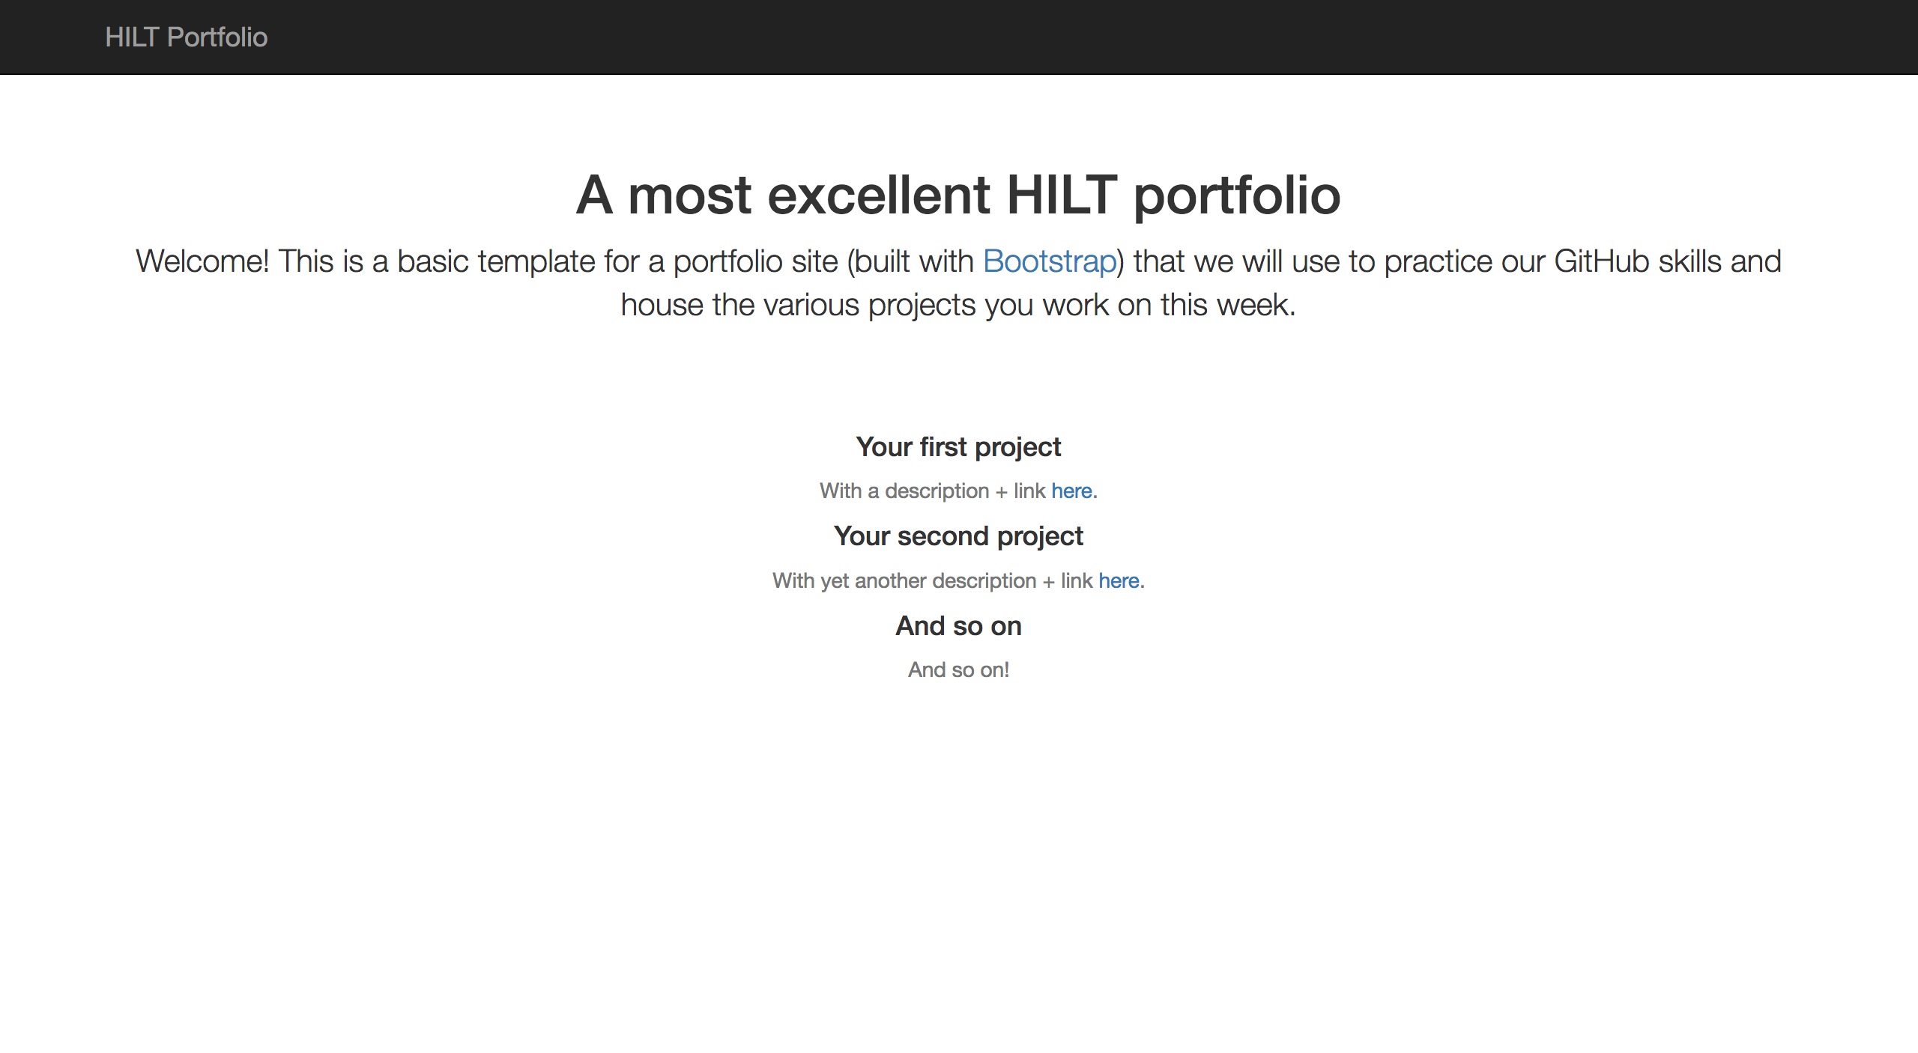
Voila!
Visit <username>.github.io in the browser
You've got a portfolio!

Slide 25
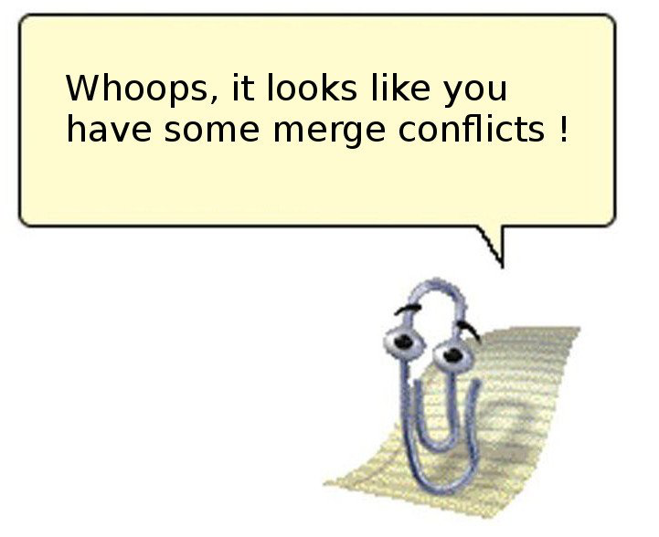

Slide 26
https://www.amarinfotech.com/gitlab-vs-github-vs-bitbucket.html

Slide 27
Last Steps
$ git config --global user.name “Your Name”
$ git config --global user.email “you@place.edu”
$ git config --global core.editor atom
$ git config --list

